Slide 1
‘Growth Pole Theory’
By
Francois Perroux
Dr. Kaustuv Mukherjee
Asstt. Prof. in Geography
Chandidas Mahavidyalaya

Slide 2
Introduction
French regional economist Francois Perroux in 1955
Phenomena of economic development with the process of structural change.
He attempted to explain how the modern processes of economic growth deviates from the stationary concepts.

Slide 3
Concept:
Any growth that takes place basically occurrs towards a specific location which is a result of discontinuous growth and location.
NH based growth
Growth can be divided on the basis of economic space.
Economic Space has –
Homogeneous Nature
Economic Plan
Force which communicate within the element

Slide 4
Main Theme:
The central idea of the growth poles theory is that economic development, or growth, is not uniform over an entire region, but instead takes place around a specific pole (or cluster). This pole is often characterized by core (key) industries around which linked industries develop, mainly through direct and indirect effects. Core industries can involve a wide variety of sectors such as automotive, aeronautical, agribusiness, electronics, steel, petrochemical, etc. Direct effects imply the core industry purchasing goods and services from its suppliers (upstream linked industries), or providing goods and services to its customers (downstream linked industries). Indirect effects can involve the demand for goods and services by people employed by the core and linked industries supporting the development and expansion of economic activities such as retail.

Slide 5
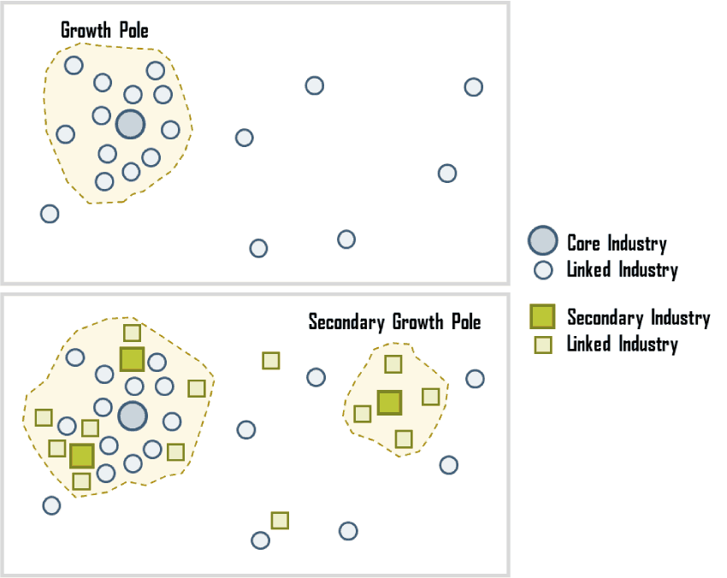

Slide 6
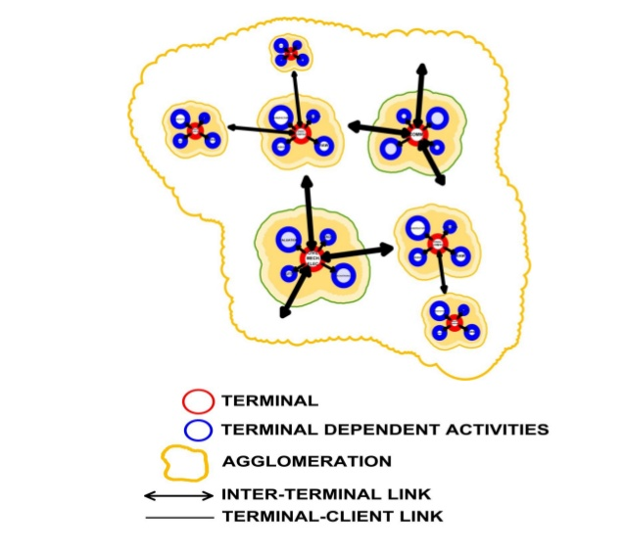
This figure needs to be elaborated. You can see that based on terminal and terminal dependent activities the growth of an area depends.

Slide 7
Main Base of His Theory:
Theory of Development
Growth is not seen everywhere it is seen in the form of cluster or agglomeration.
Inter-Industrial Linkages
The area where industries are set up will be having some sort of linkages.
Cotton
Cloth
T-Shirts, Jeans

Slide 8
3 Main Basis of Growth Pole Theory
External Economies – (Positive or Negative)
Agglomeration
Linkages – (Forward or Backward)
This three points need to be elaborated.

Slide 9
Growth Pole
Propulsive Growth
Polarization
Growth Pole Theory
Dynamic
Leading

Slide 10
Evaluation:
This is your part where you have to evaluate the theory whether it is good or bad.
Mention the positives and negatives of the theory as well as applicability with examples.

Slide 11
Thank You

